Slide 1

If you haven’t already…
Go to github and create an account and
download GitHub Desktop

Slide 2

Repository Basics

Slide 3
What you will use GitHub for…
Store all your code and projects safely
Share your code and projects
Create a portfolio to link on your CV or to your LinkedIn

Slide 4
What it also can be used for
Version Control - the primary use of GitHub is to store a copy of code everyone in a data team can work on. Individuals make changes on a “branch” and create a “pull request” for team mates to review and approve before adding.
Apps - we’re not building an app as you might see in some developers GitHub accounts. The focus is on presenting your analytical skills

Slide 5
Creating a Repository

Slide 6
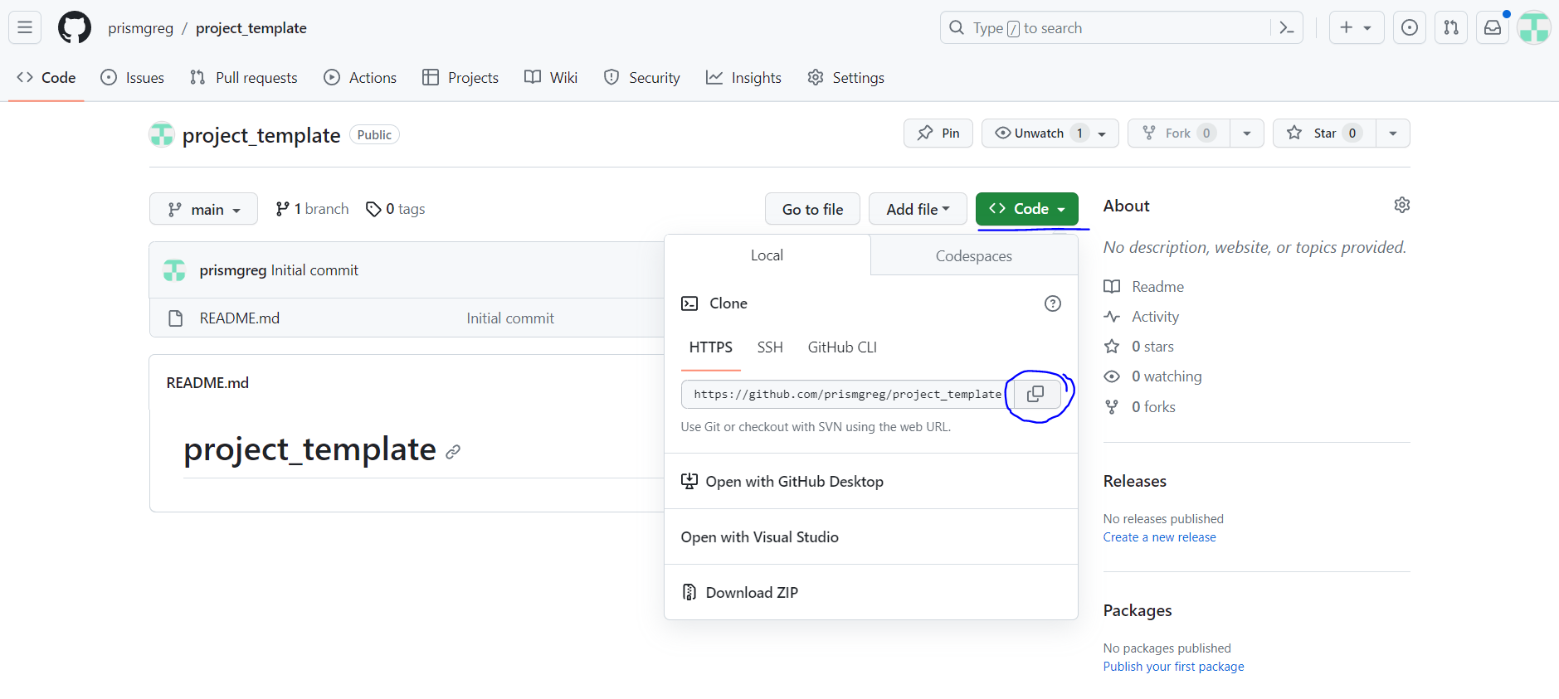
Let’s use this template…

Slide 7
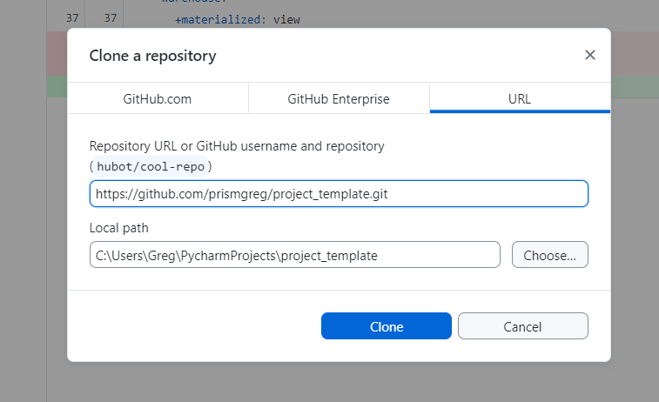
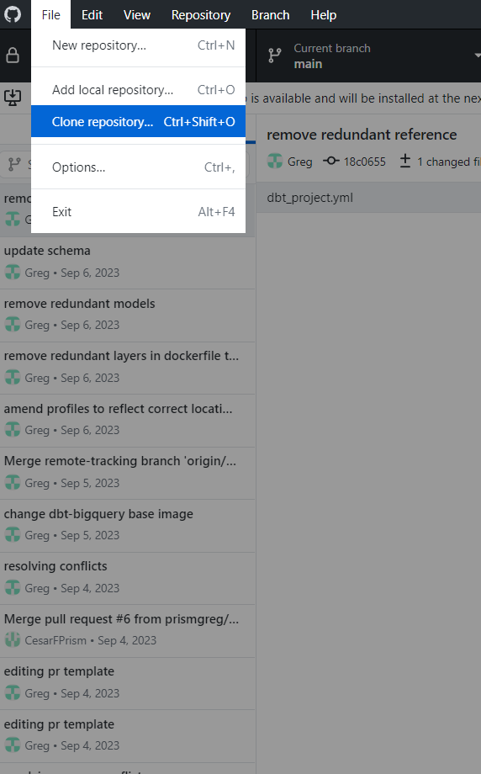
Clone the example repository (essentially downloads it)

Slide 8
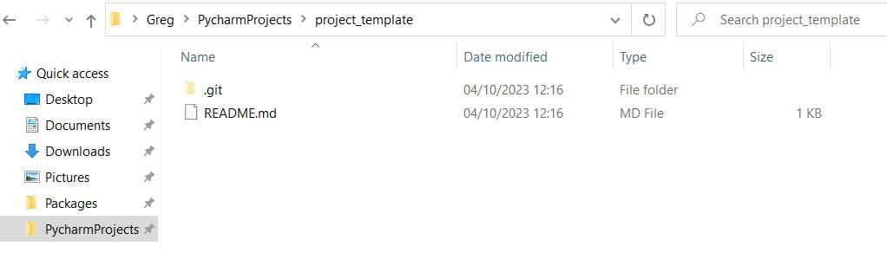
You can add files to the repository or edit them locally

Slide 9
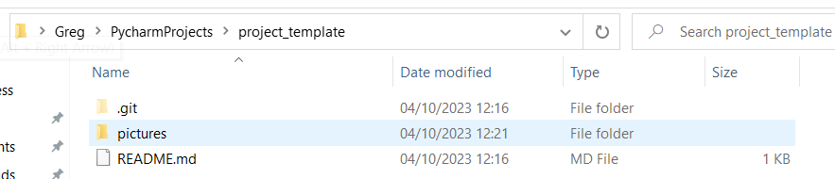
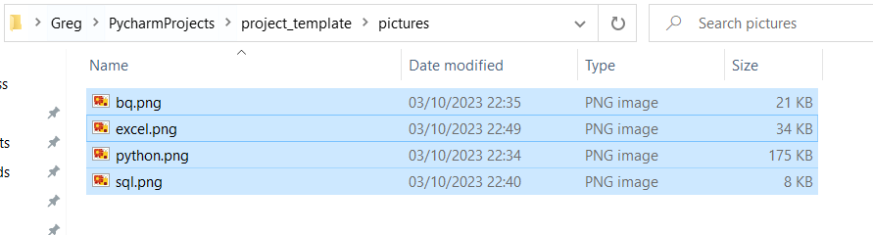
Let’s add some pictures to use in our readme

Slide 10
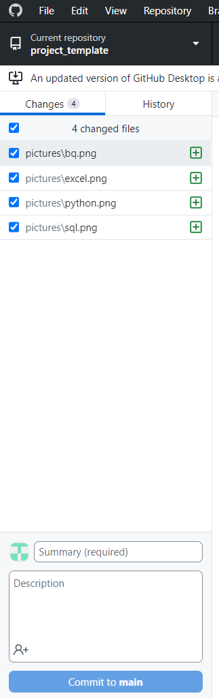
We have those locally, we now want to push them to GH…
See how the new files appear?
Git can see the changes we’ve made locally
We must commit them for git to save them
We should commit each time we’ve made a series of changes we are happy with
Let’s commit our changes, we should also add a description

Slide 11
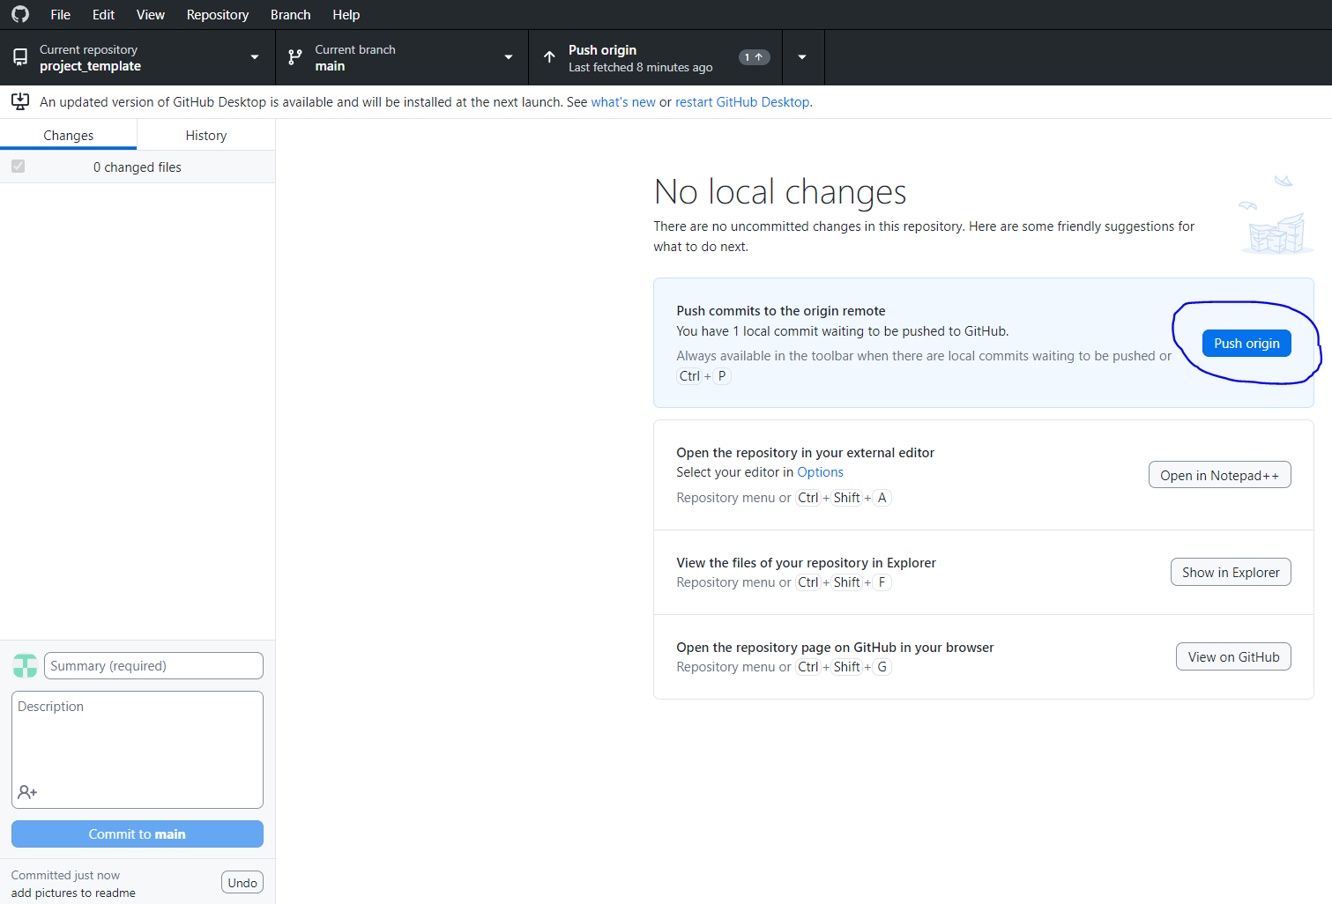
We can see our commit was successful below.
This has saved our changes to git locally
Now we push them to GitHub and they will be stored in our online repository… Click push origin

Slide 12
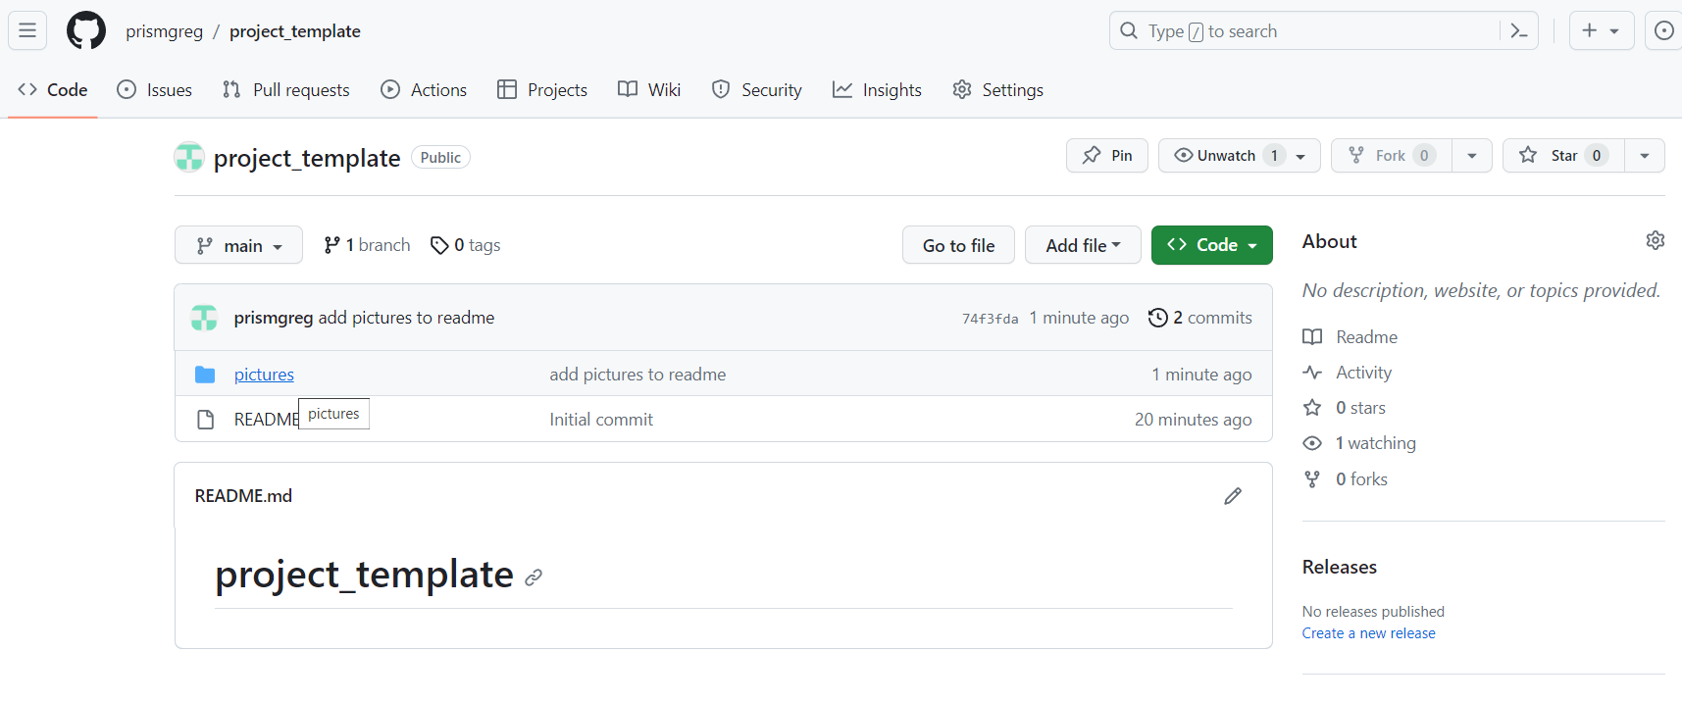
Our changes are now visible!

Slide 13
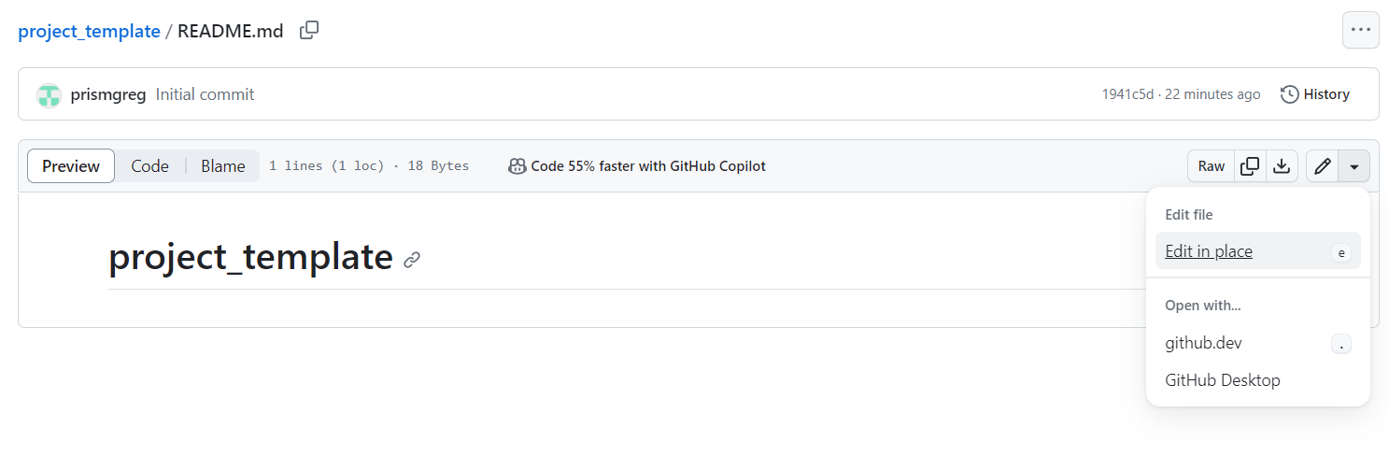
Now let’s edit the readme… This is easiest to do on github (or in a text editor locally, but we’ll do it on github for now)
Click on the readme.md file and go to edit in place

Slide 14
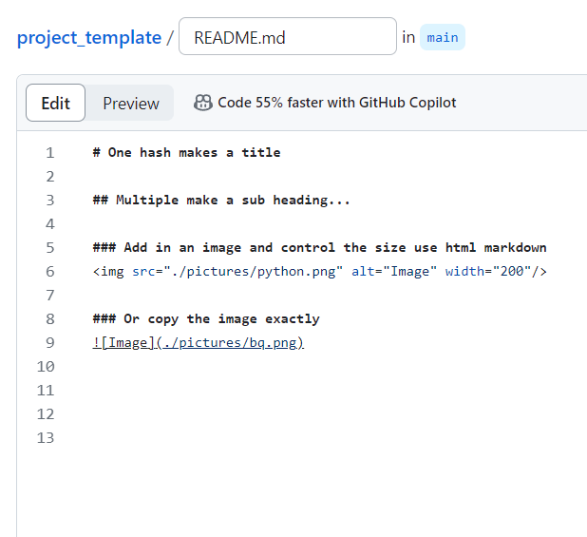
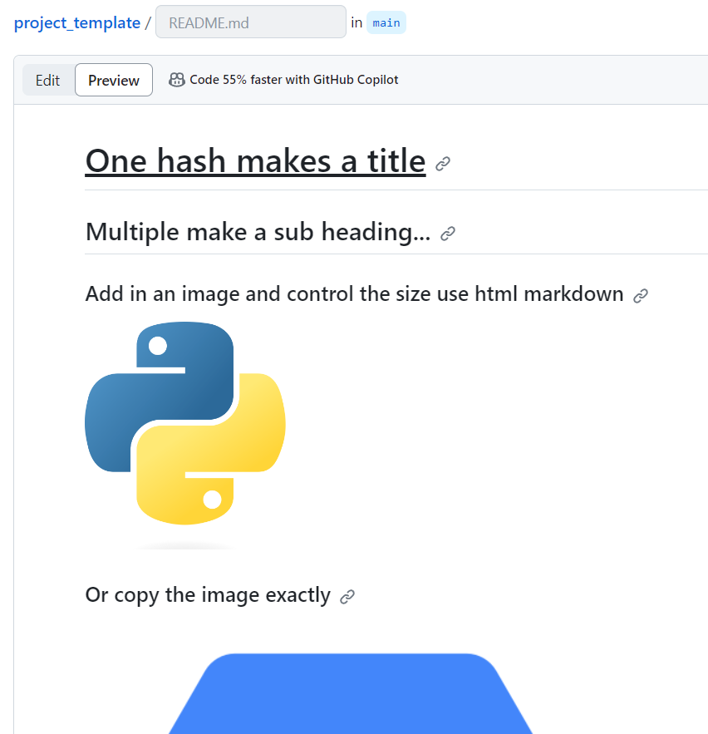
Make some changes and then preview them…

Slide 15
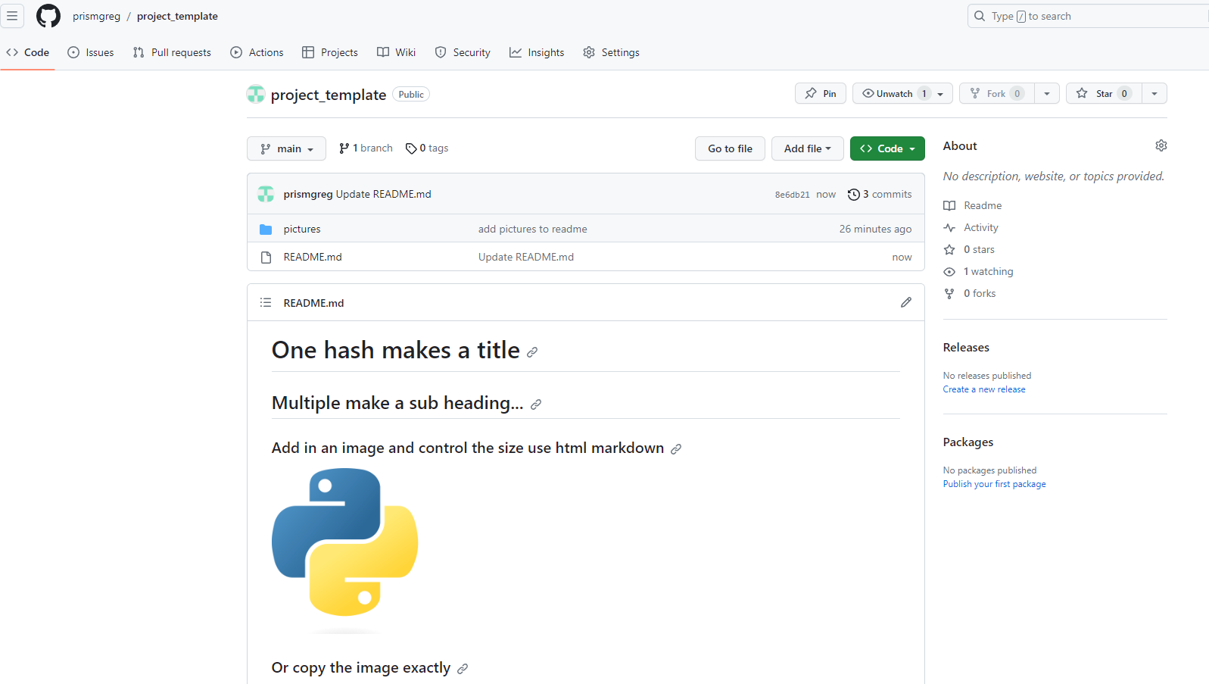
Commit your changes and go back to the repository. You should see your changes appear!

Slide 16
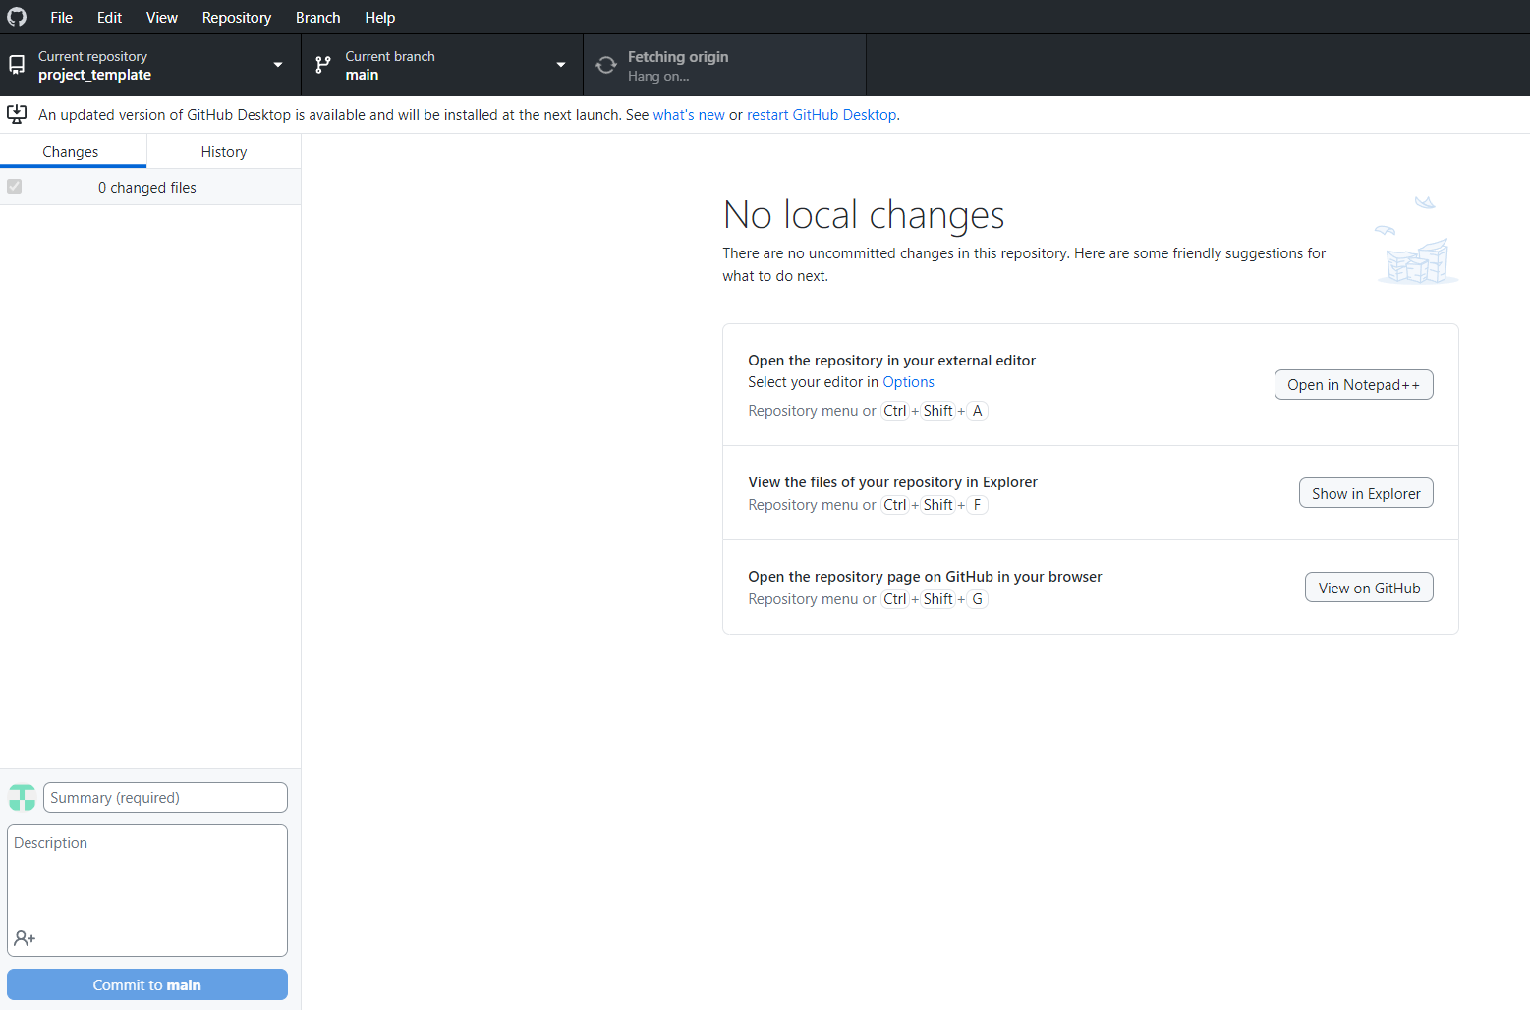
However we’ve now made these changes on github… So our local version doesn’t. We need to pull them!
Click fetch origin
This will pull any changes on the repository to your local
They should now match!

Slide 17
Take home project…
There are many public datasets on BigQuery that you can access. A highly sought after skill is familiarity with Google Analytics.
For next week take a look at the ga4 sample dataset (more info here)
This is an altered Google Analytics e-commerce dataset

Slide 18
Take home project…
What you need to demonstrate:
Conduct analysis of the GA4 dataset using BigQuery and a data visualisation tool of your choosing.
Frame your ReadMe.md in the CAR format:
Context, Action, Results
Insert the visualisations and you can also save your sql files (copy to notepad and save with a .sql extension)

Slide 19
For some inspiration…
Example data science project
A fun GitHub profile
Creating a portfolio

